Slide 1
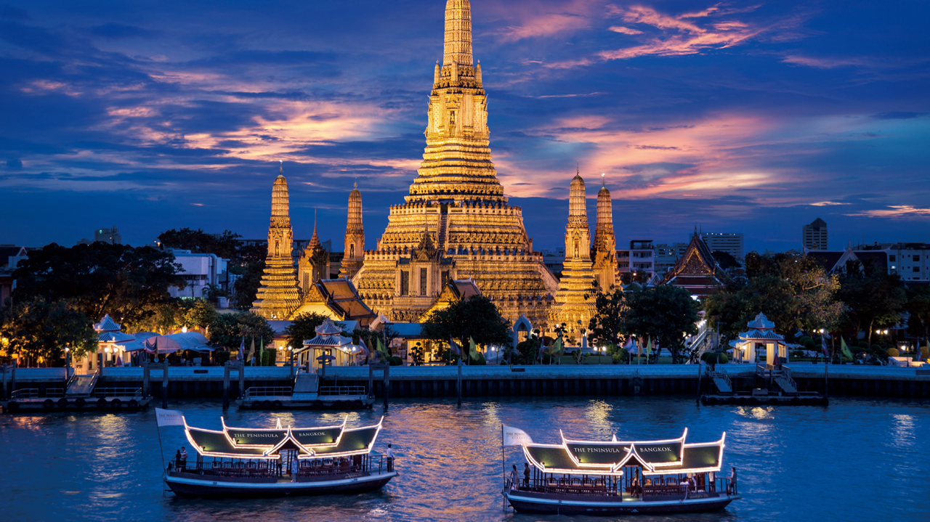
BANGKOK

Slide 2
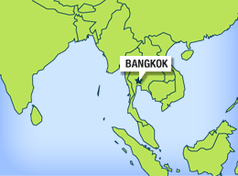
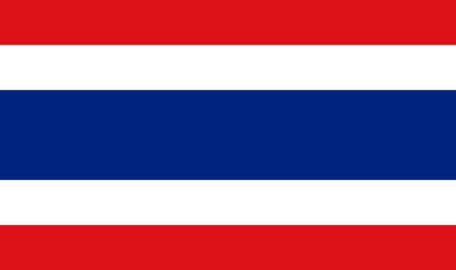
Bangkok was founded in 1782 by the
king Rama I
Population: 8.280.295
Flag:
Bangkok is the capital of Thailand in Asia

Slide 3
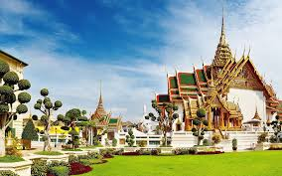
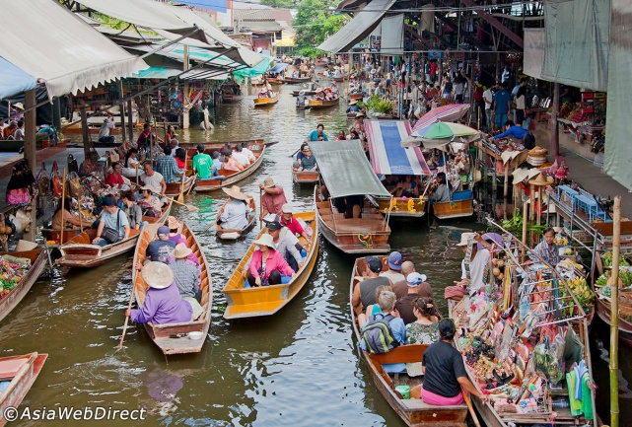
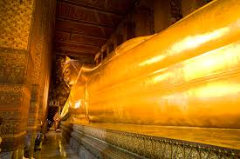
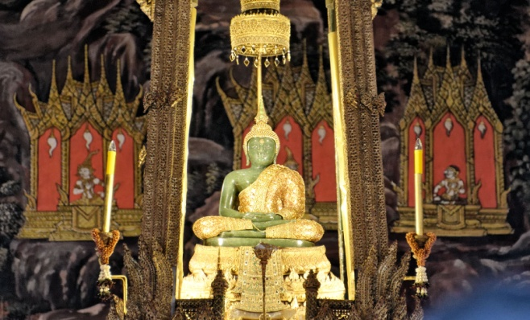
IMPORTANT PLACES TO VISIT
The grand palace
The floating market
Temple of the reclining Buddha
Temple of the emerald Buddha

Slide 4
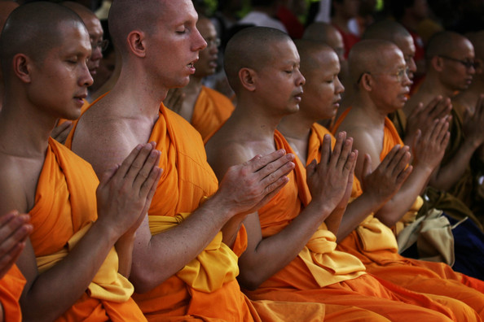
RELIGION
Bhuddist monks wear special clothes called ``civara``,

Slide 5
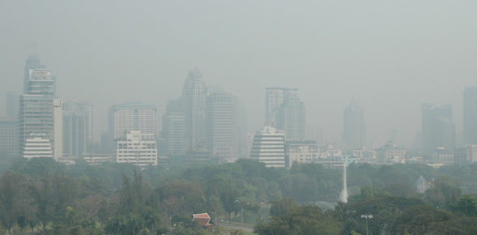
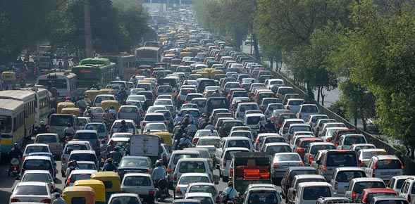
POLUTION
Cause:

Slide 6
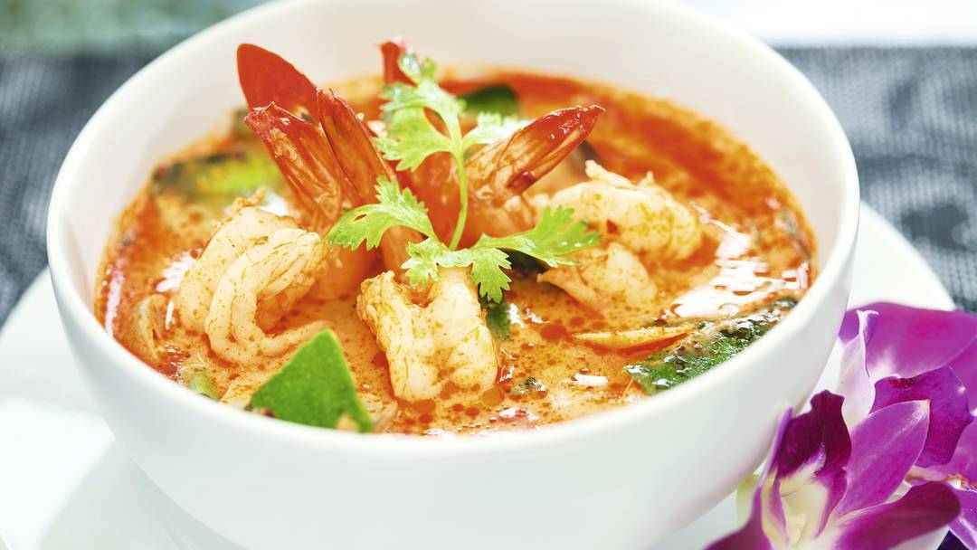
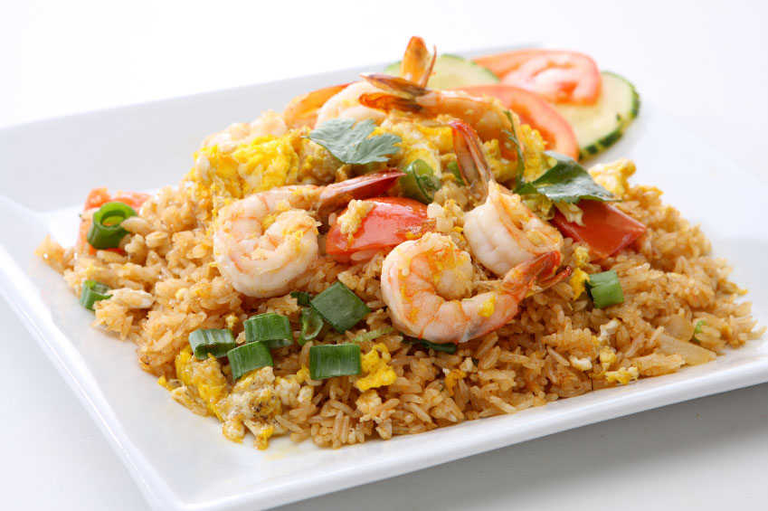
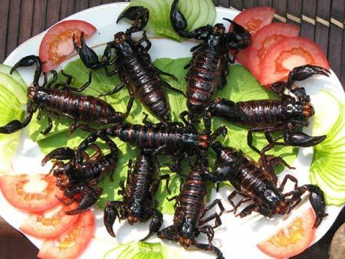
TYPICAL FOOD
Tom Yum
Khao pad
Fried insects

Slide 7
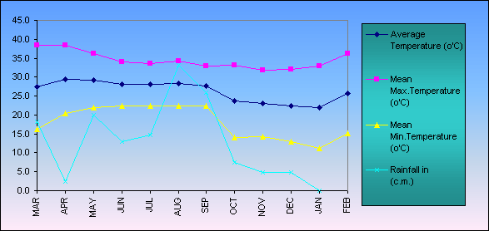
WEATHER

Slide 8
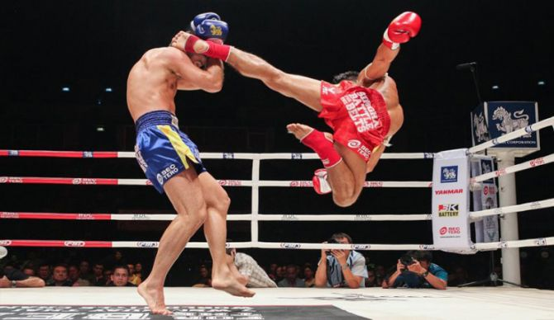
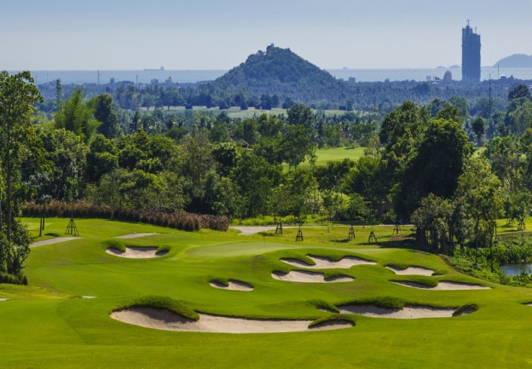
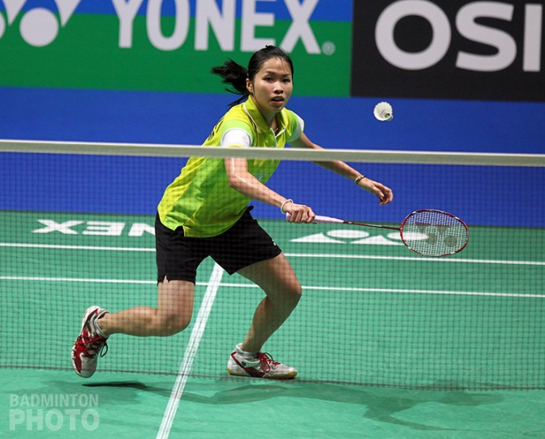
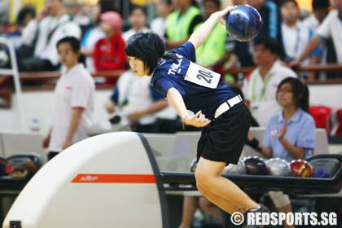
TYPICAL SPORTS & common sports

Slide 9
VIDEO
https://www.youtube.com/watch?v=NNLUOCbyEkA

